Slide 1
Object detection algorithms
Single shot multi box detector (SSD)

Slide 2
Classification and Object detection
Image classification in computer vision takes an image and predicts the object in an image, while object detection not only predicts the object but also finds their location in terms of bounding boxes. For example, when we build a swimming pool classifier, we take an input image and predict whether it contains a pool, while an object detection model would also tell us the location of the pool.

Slide 3
Object detection
For illustrative purpose, assuming there is at most one class and one object in an image, the output of an object detection model should include:
Probability that there is an object,
Height of the bounding box,
Width of the bounding box,
Horizontal coordinate of the center point of the bounding box,
Vertical coordinate of the center point of the bounding box.

Slide 4
Windowing
It's natural to think of building an object detection model on the top of an image classification model. Once we have a good image classifier, a simple way to detect objects is to slide a 'window' across the image
But there is problems like:
How do you know the size of the window

Slide 5
In practice, there are two types of mainstream object detection algorithms:.
R-CNN and Faster R-CNN
YOLO (You Only Look Once) and SSD (Single-Shot Detector)
two-step approach
First to identify regions where objects are expected to be found
Second detect objects only in those regions using Convolutional.
Use a fully convolutional approach in which the network is able to find all objects within an image in one pass
Better accuracy but slower to run, while single-shot algorithms are more efficient and has as good accuracy

Slide 6
Single-Shot Detector (SSD)
SSD has two components: a backbone model and SSD head.
Backbone model usually is a pre-trained image classification network as a feature extractor. This is typically a network like ResNet trained on ImageNet from which the final fully connected classification layer has been removed. We are thus left with a deep neural network that is able to extract semantic meaning from the input image while preserving the spatial structure of the image albeit at a lower resolution

Slide 7
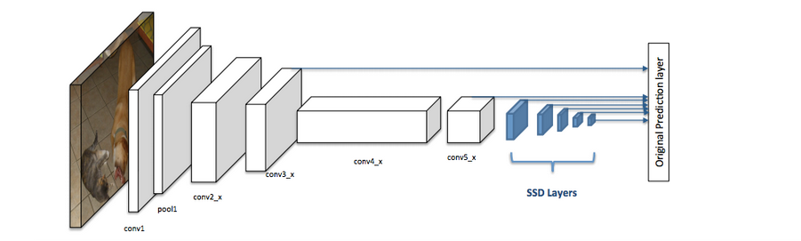
Single-Shot Detector (SSD)
The SSD head is just one or more convolutional layers added to this backbone and the outputs are interpreted as the bounding boxes and classes of objects in the spatial location of the final layers activations.

Slide 8
Important concepts/parameters in SSD.
Grid cell
Instead of using sliding window, SSD divides the image using a grid and have each grid cell be responsible for detecting objects in that region of the image. Detection objects simply means predicting the class and location of an object within that region. If no object is present, we consider it as the background class and the location is ignored.

Slide 9
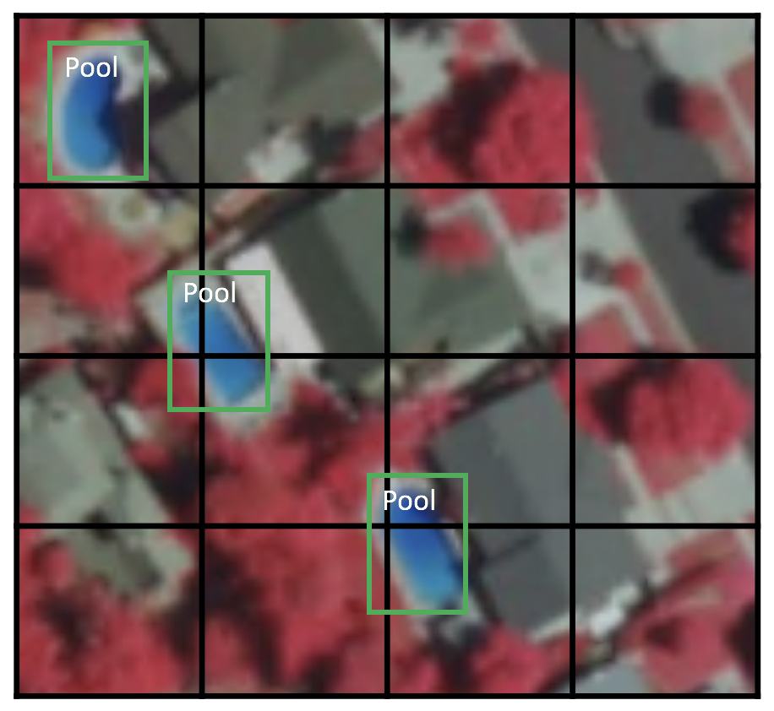
Grid cell
Now you might be wondering what if there are multiple objects in one grid cell or we need to detect multiple objects of different shapes. There is where anchor box and receptive field come into play

Slide 10
Anchor box
Each grid cell in SSD can be assigned with multiple anchor/prior boxes. These anchor boxes are pre-defined and each one is responsible for a size and shape within a grid cell
SSD uses a matching phase while training, to match the appropriate anchor box with the bounding boxes of each ground truth object within an image. Essentially, the anchor box with the highest degree of overlap with an object is responsible for predicting that object’s class and its location.
In practice, each anchor box is specified by an aspect ratio and a zoom level.

Slide 11
Aspect ratio
Not all objects are square in shape. Some are longer and some are wider, by varying degrees. The SSD architecture allows pre-defined aspect ratios of the anchor boxes to account for this. The ratios parameter can be used to specify the different aspect ratios of the anchor boxes associates with each grid cell at each zoom/scale level.

Slide 12
Zoom level
It is not necessary for the anchor boxes to have the same size as the grid cell. We might be interested in finding smaller or larger objects within a grid cell. The zooms parameter is used to specify how much the anchor boxes need to be scaled up or down with respect to each grid cell.

Slide 13
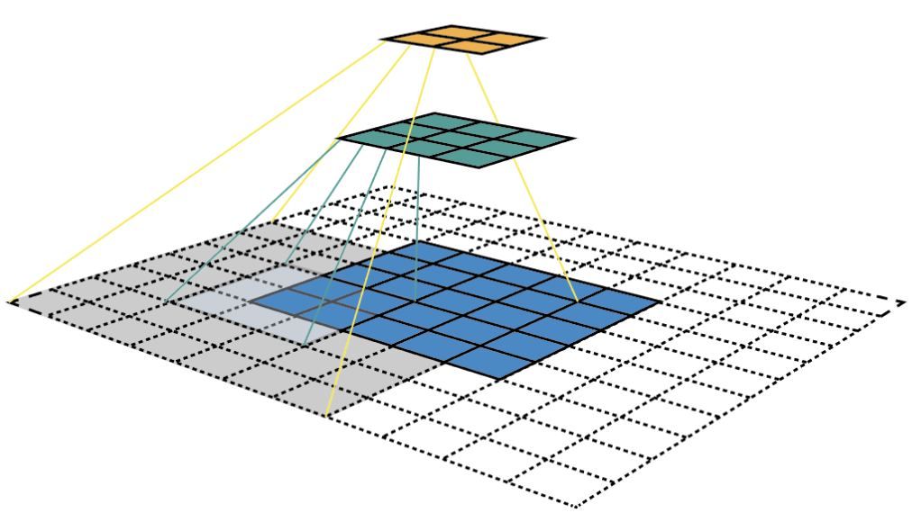
Receptive Field
Receptive field is defined as the region in the input space that a particular CNN’s feature is looking at

Slide 14
SSD implementation
We can define a SSD architecture just through a single line of code by using API called ArcGIS. Learn

Slide 15
Thanks
Eng. Mohammed Radwan

